Slide 1


HELP CTIS
Website
BIT302 – Software Engineering

Slide 2

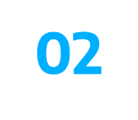
Group Members
Team Leader
Name : I Made Siva Aditya Surya
Student ID : E1800176
Contact : sivaaditya0908@gmail.com
Member
Name : Ida Bagus Gede Awidya Andika
Student ID : E1800182
Contact : awidyaandika@gmail.com

Slide 3
Use Cases in Iteration 2
Use Case | Developed by
Manage Test Kit Stock | Ida Bagus Gede Awidya Andika
Record Officer | Ida Bagus Gede Awidya Andika
Record Tester | Ida Bagus Gede Awidya Andika
View Test Kit | Ida Bagus Gede Awidya Andika
View Test Centre Officer | Ida Bagus Gede Awidya Andika

Slide 4
Use Cases in Iteration 2
Use Case | Developed by
Generate Test Report | I Made Siva Aditya Surya
Record Patient | I Made Siva Aditya Surya
Record New Test | I Made Siva Aditya Surya
Update Test Result | I Made Siva Aditya Surya
View Testing History | I Made Siva Aditya Surya

Slide 5
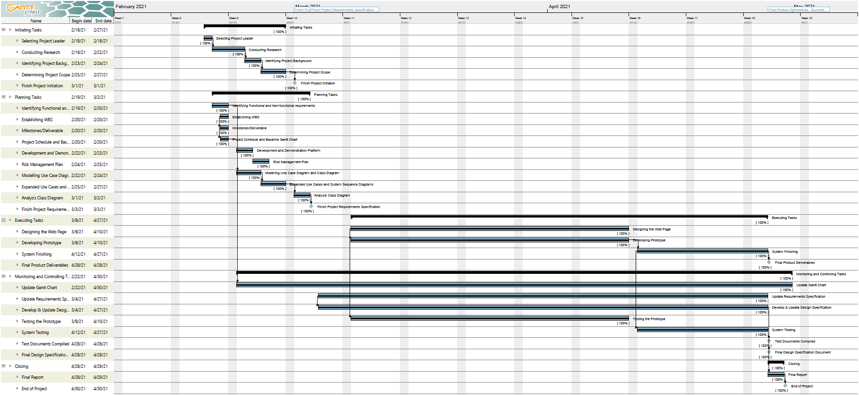
Final Gantt Chart

Slide 6
Updated Github

Slide 7
Work Produced http://helpctis.great-site.net/public/

Slide 8
Thank You

